Slide 1
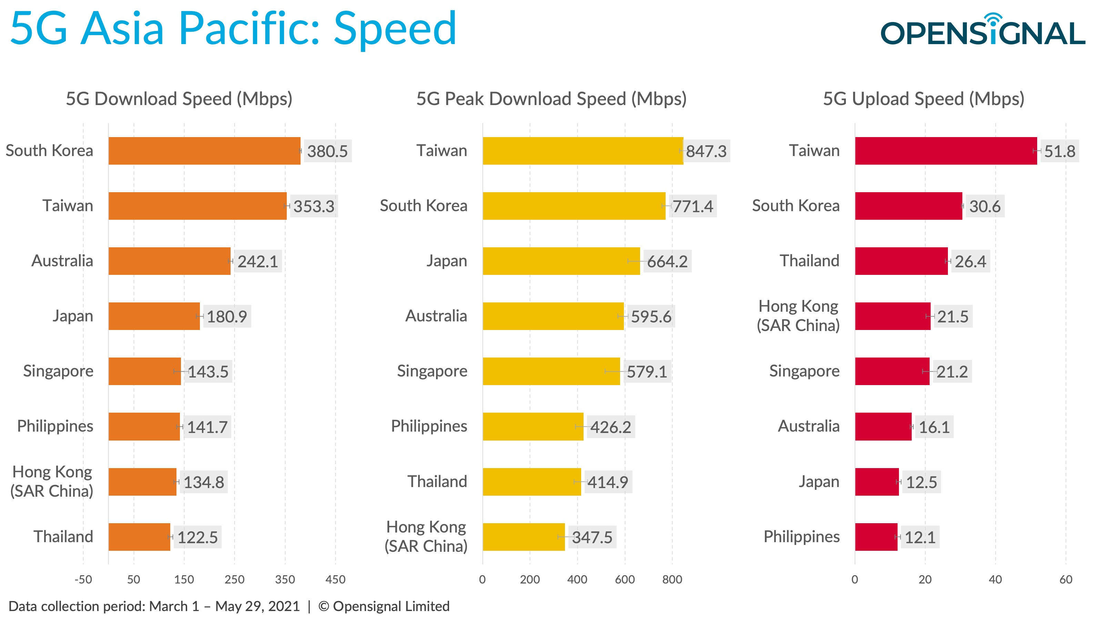
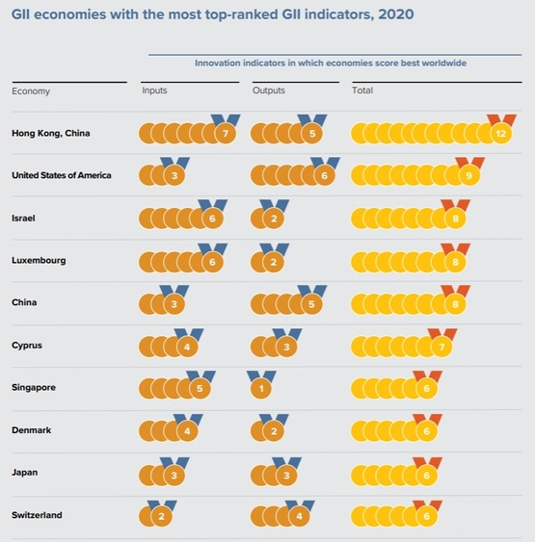
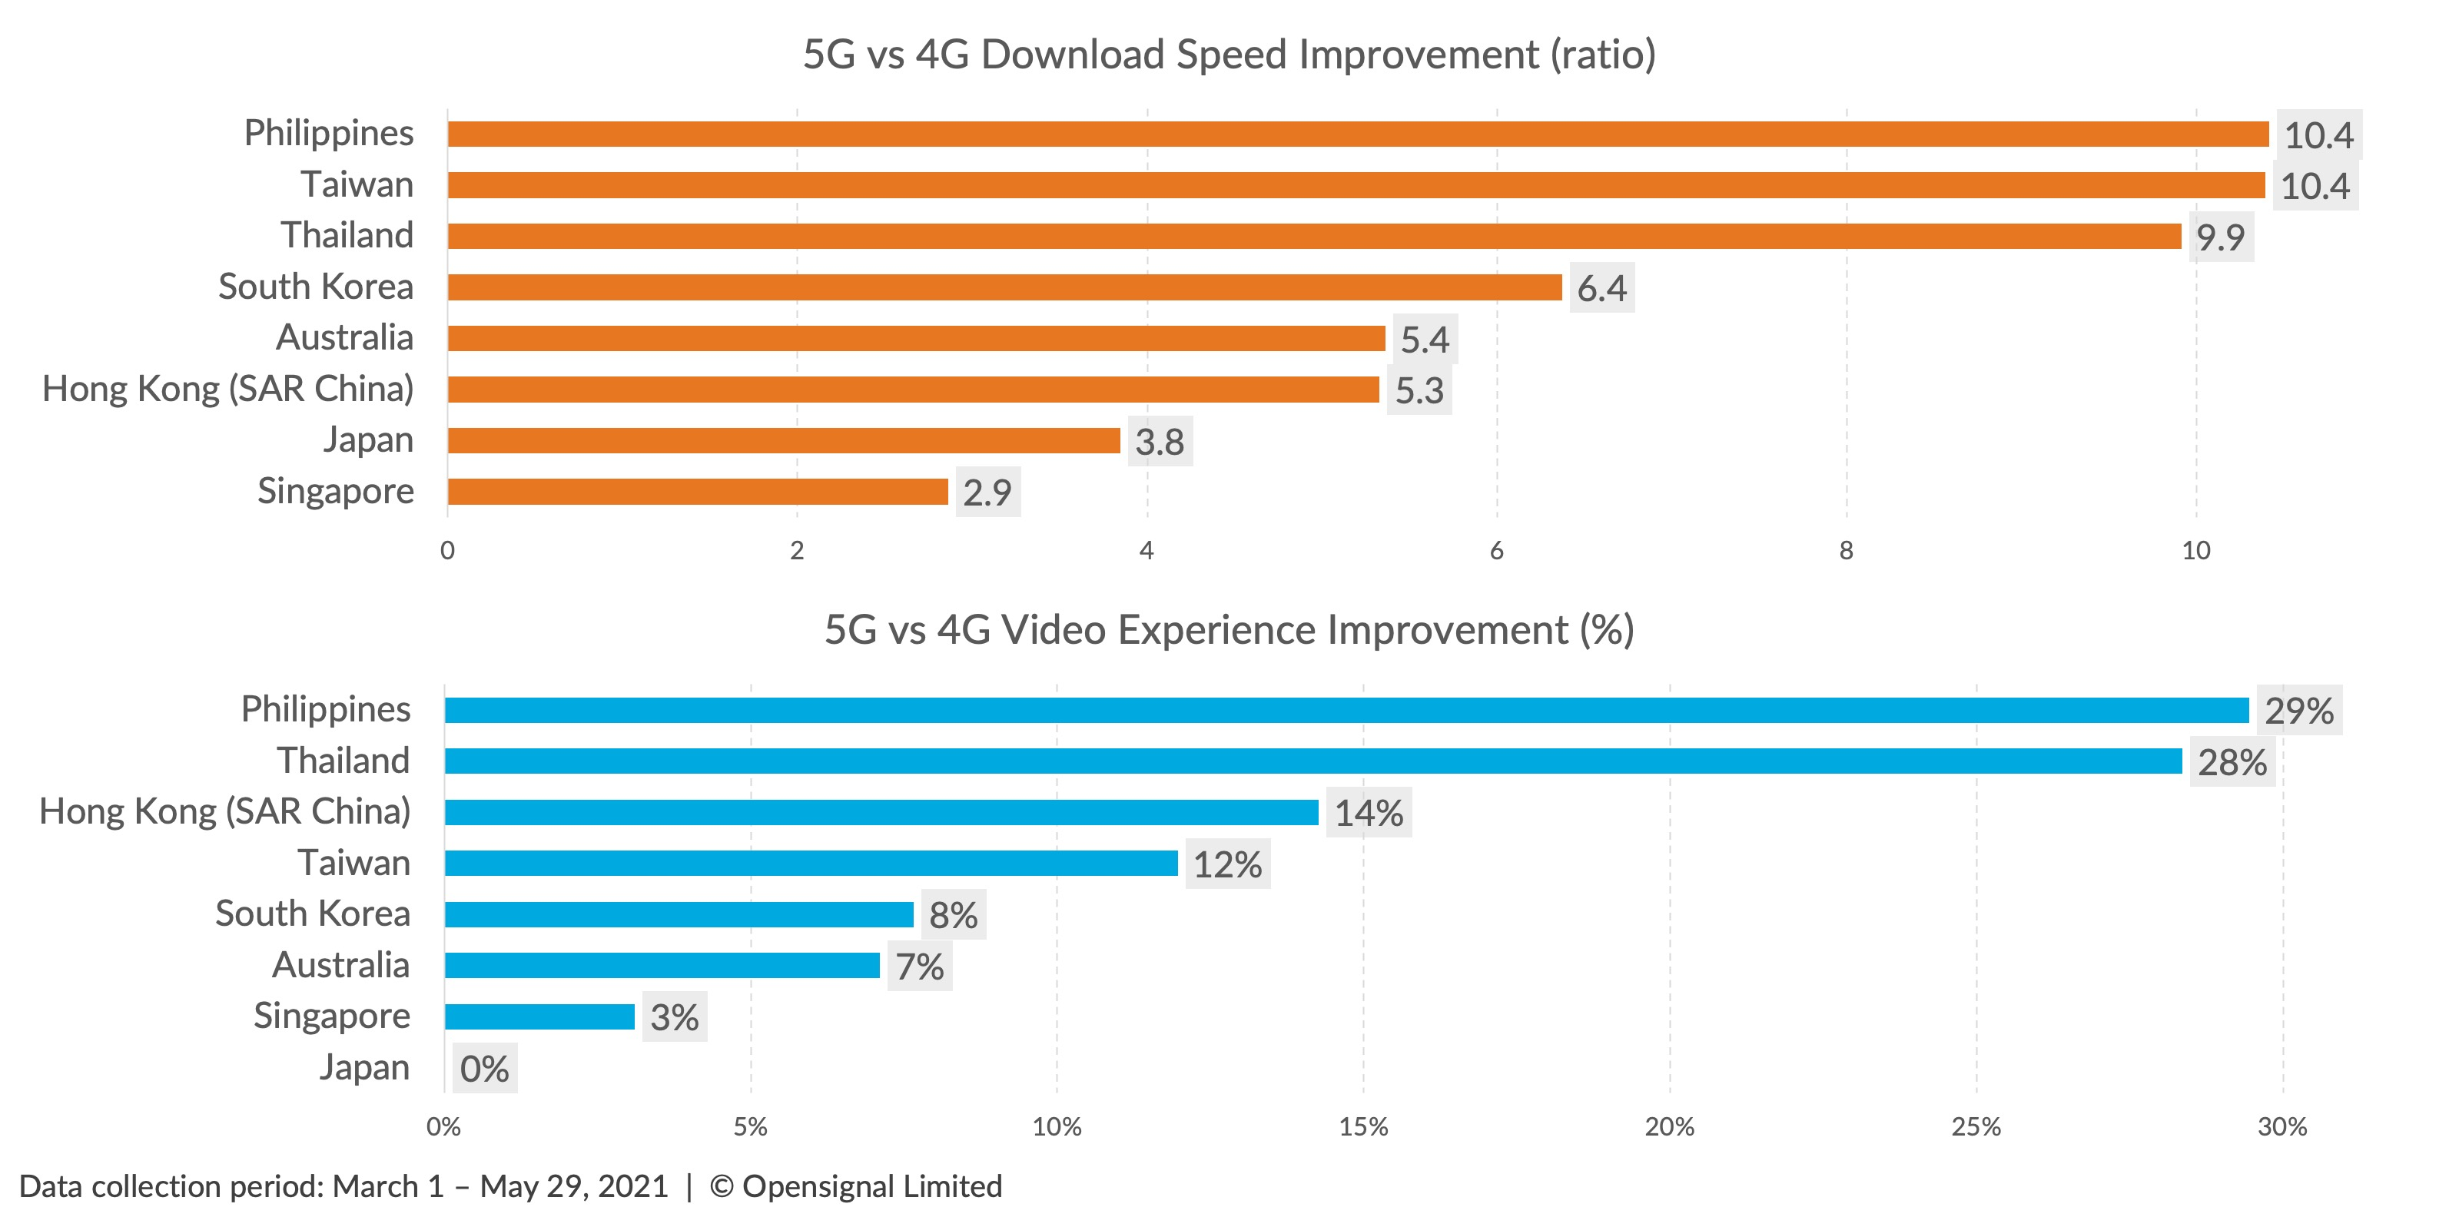
The Hong Kong Government provides telecommunications operators with financial incentives. Thus, 5G network coverage has now expanded over 95 percent and its quality is ranked to the top in Asia Pacific
GII economics with The most top-ranked
GII Indicators, 2020
5G Asia Pacific : Speed
Hong Kong also continues to top the world in specific areas of innovation such as venture capital, R&D, entrepreneurship, and high‑tech production. As the results, Hong Kong was the 1st ranked in 2020.
Besides, Hong Kong was also in top 10 ranked in term of speed and experience uplift in Asia Pacific.
Thus, the subsidies from the government directly relevant to the deployment of 5G technology in an approvement of its quality and innovations.
5G Asia Pacific : Uplift

